Slide 1
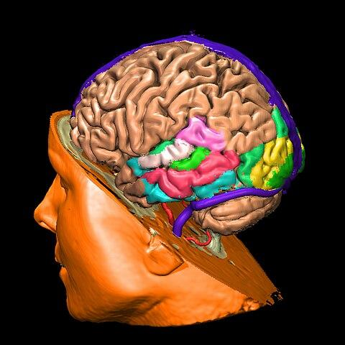
Revolutionizing 3D Brain Tumor Segmentation with SLMSA Network for Transformative Neuro-Insights
By Harini Balaji

Slide 2

Agenda
What is this project about?
Why this project?
How does this project work?
Results
Conclusion

Slide 3
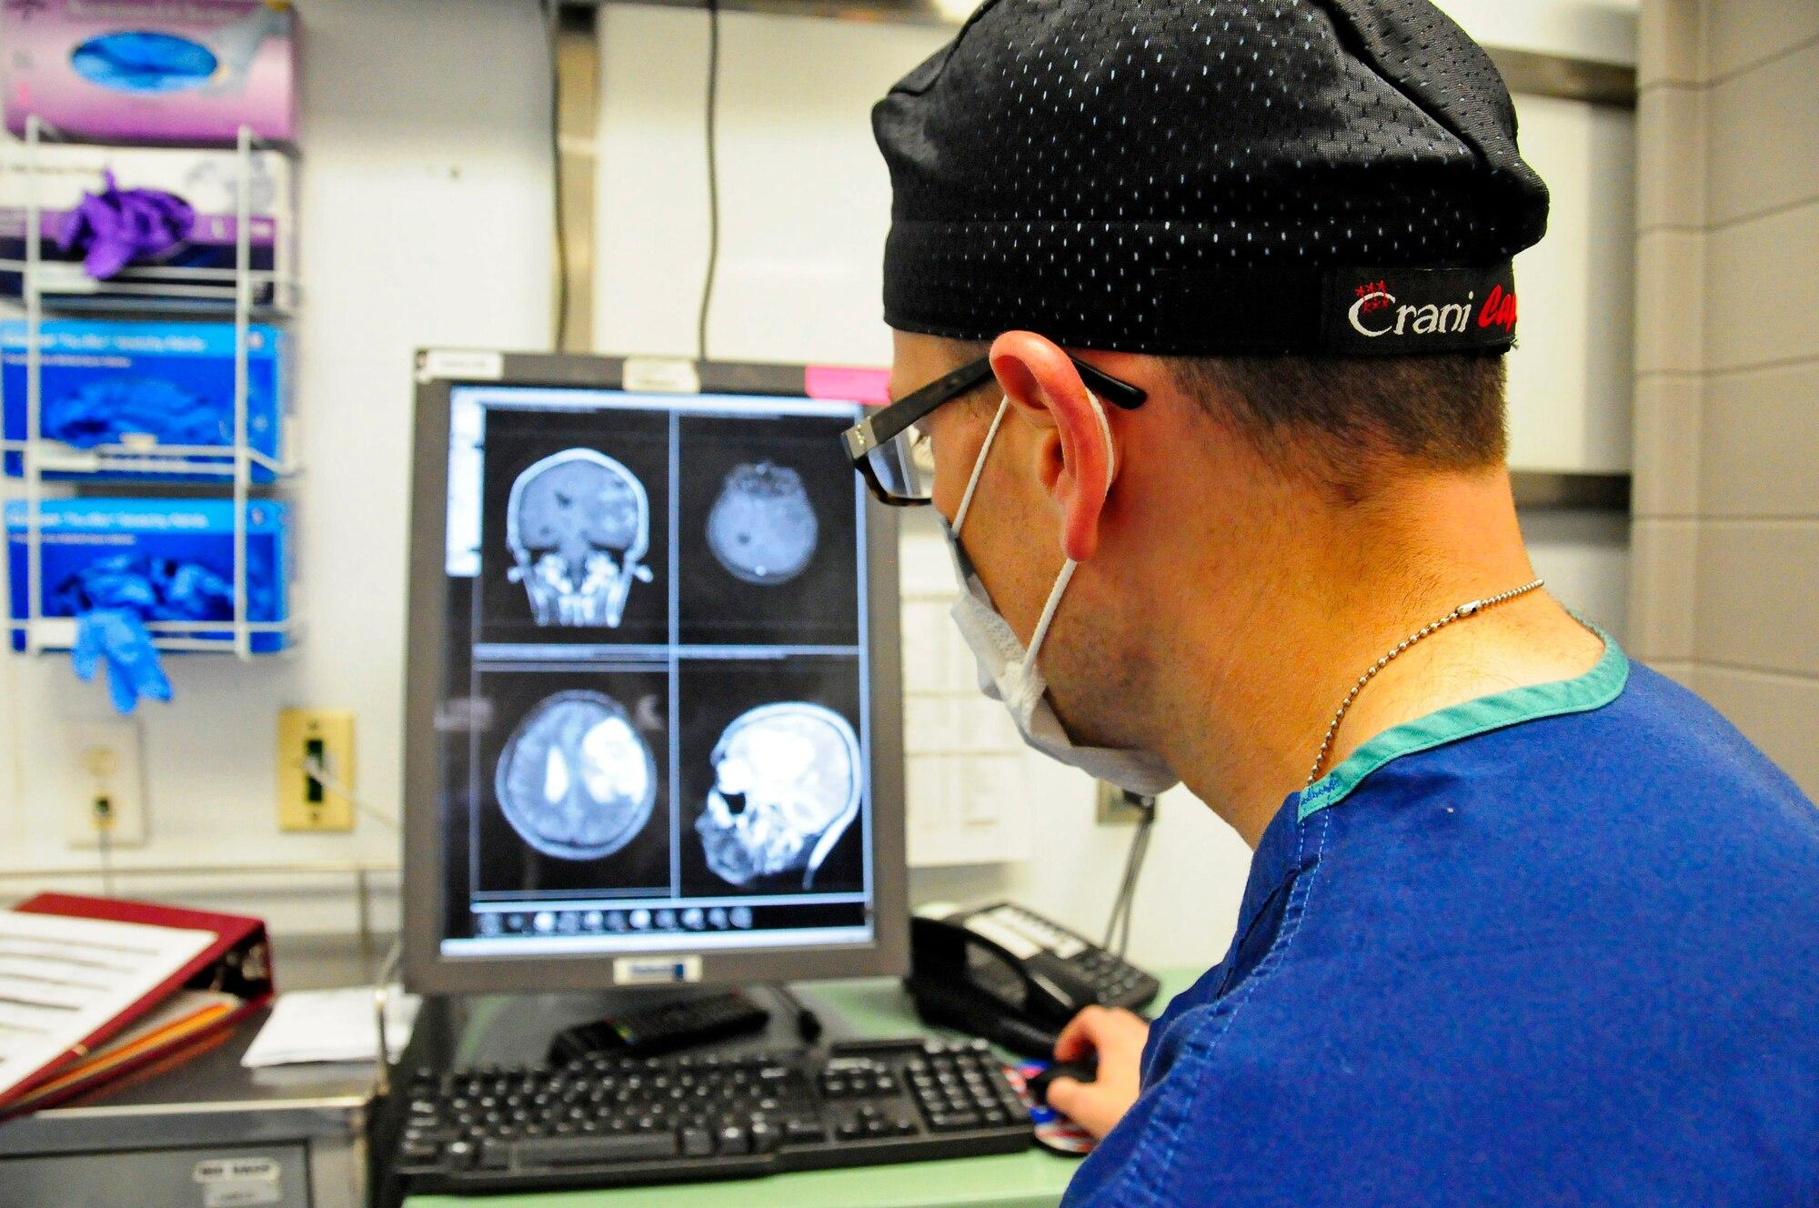
Introduction:
Early diagnosis is critical; 3D medical image segmentation is key for effective diagnosis and treatment planning.
Challenges with Traditional and Deep Learning Methods:
Traditional methods struggle with diverse tumor shapes and textures.
Deep learning approaches like CNNs and Transformers have limitations in handling 3D images and global features.
Proposed Solution - SLM-SA Network:
Short-Term and Long-Term Memory Self-Attention (SLM-SA) network proposed to address limitations.
Combines strengths of CNNs and Transformers for accurate and real-time 3D tumor segmentation.

Slide 4
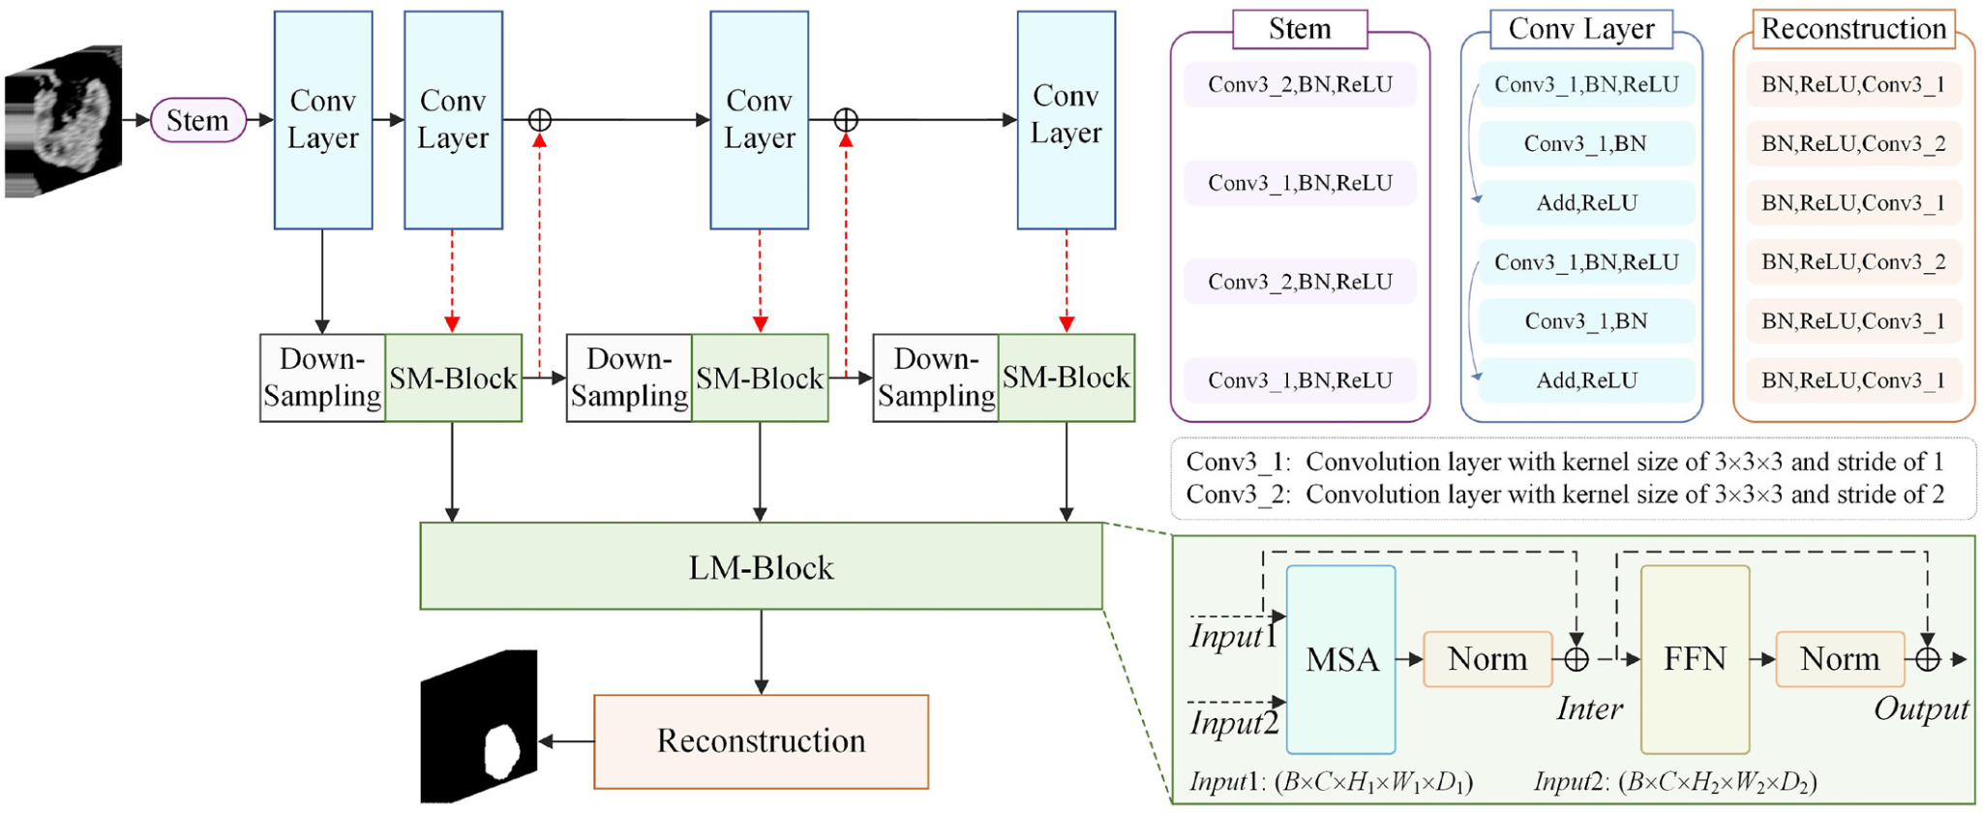
Short-term and Long-term Self-Attention (SLM-SA) Network Architecture
Features:
Initial processing with a Feature Extraction Module.
Two Branches:
Local Features Branch extracts local features.
Attention Branch (SM-SA) optimizes convolution output.
Close combination of Branches for effective information utilization.
Long-Term Memory Self-Attention (LM-SA) utilizes global features.
Image Reconstruction Module predicts tumor boundaries.
Maintains real-time application speed without sacrificing accuracy.
Contributions and Validation:
SLM-SA Network proposed as an efficient solution.
Achieves a balance between processing speed and segmentation accuracy.

Slide 5
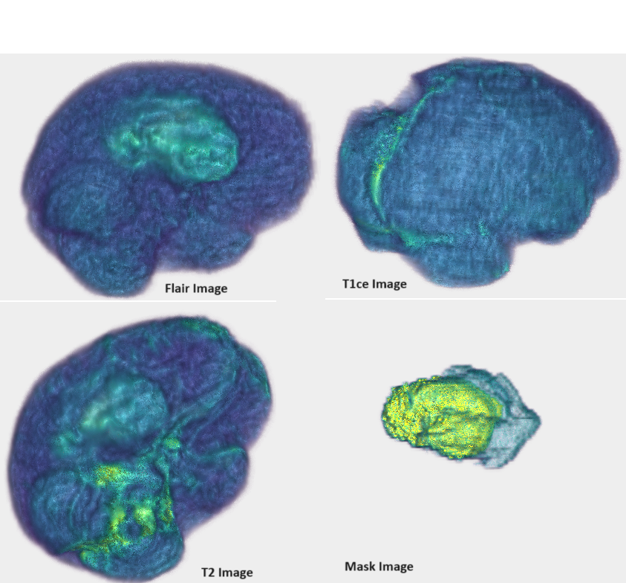
MRI Scan Types:
Native (T1): T1-weighted MRI without contrast agents, good for anatomy visualization.
Post-Contrast T1 (T1Gd): Acquired after contrast agent administration, highlights regions with increased permeability, like tumor tissue.
T2-weighted (T2): Provides information about water content, useful for visualizing abnormalities.
T2 Fluid Attenuated Inversion Recovery (T2-FLAIR): Specialized sequence suppressing cerebrospinal fluid signal, aids in detecting abnormalities near fluid-filled spaces.
Manual Annotations by Neuro-Radiologists:
GD-enhancing Tumor (ET): Portion of the tumor enhancing with contrast (Gd), often indicating the active, proliferating part of the tumor.
Peritumoral Edema (ED): Abnormal accumulation of fluid around the tumor, associated with increased pressure and potential impact on nearby brain structures.
Necrotic/Non-Enhancing Tumor Core (NCR/NET): Central portion of the tumor that may not enhance with contrast, indicating tissue death (necrosis) and less active or dormant tumor tissue.
Brats2020 Data 3D View using itkwidge

Slide 6
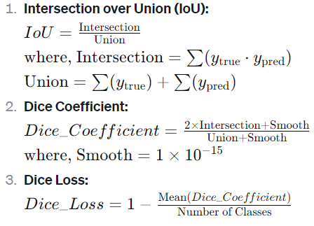
Model Training:
AdamW Optimizer:
Variant of Adam optimizer for training deep neural networks.
Introduces weight decay directly into the optimization step.
Weight decay is a regularization term penalizing large weights to prevent overfitting.
Key difference: Weight decay applied directly to weights during update step, not in the loss function.
Can lead to improved generalization performance.
Intersection over Union (IoU) Metrics:
Commonly used metric for image segmentation model evaluation.
Measures overlap between predicted and ground truth segmentations.
Calculated as intersection of predicted and ground truth regions divided by their union.
Dice Loss:
Commonly used in image segmentation tasks.
Aims to maximize similarity between predicted and ground truth segmentations.
Derived from the Dice coefficient, also known as F1 score.
Objective: Minimize Dice Loss during training for accurate segmentations.
Dice Coefficient:
Metric for quantifying similarity between two sets.
Measures overlap between predicted and ground truth segmentations.
Ranges from 0 to 1, with 1 indicating perfect overlap.
Used to evaluate segmentation accuracy in medical imaging.
Training goal: Maximize Dice Coefficient to improve segmentation precision.

Slide 7
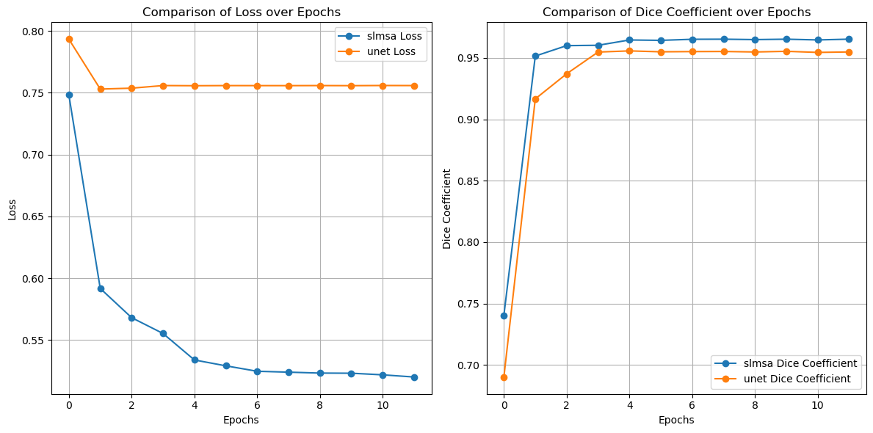
Performance Comparison of Unet and SLM-SA

Slide 8
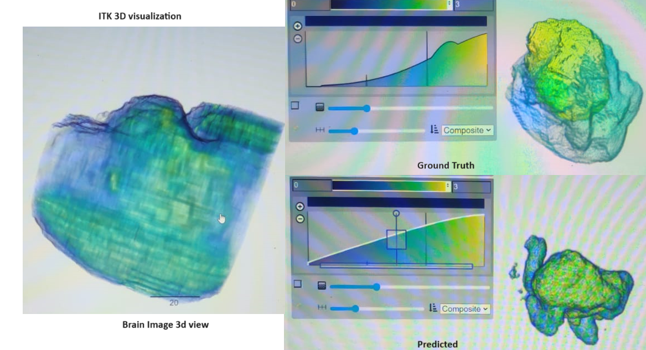
Results
3D Visualization:
Utilizes the itkwidgets library for interactive exploration of segmentation results.
Enhances the understanding of the model's performance through visual inspection
Model Proficiency:
Demonstrates remarkable performance on both training and validation datasets.
Achieves high accuracy and IoU scores, indicating proficiency in capturing intricate details of brain tumor structures in 3D.
SLMSA Model Performance:
Training Set Metrics:
Accuracy: 98.64%
IoU Score: 74.15%
Loss Value: 16.63%

Slide 9
Conclusion
The Short-Term and Long-Term Memory Self-Attention (SLMSA) model stands out for its exceptional performance in 3D brain tumor segmentation.
Interactive 3D visualization, powered by the itkwidgets library, facilitates a user-friendly exploration and understanding of the model's segmentation results.
Beyond impressive quantitative metrics, the SLMSA model emerges as a valuable tool for clinicians and researchers, offering enhanced insights into 3D brain tumor images.
In contrast to other techniques, like UNet, the SLMSA model converges earlier, highlighting its superior performance and efficacy in advancing the field of neuroimaging.
The integration of deep learning techniques with advanced visualization not only sets this model apart but also positions it as a potential catalyst for transformative insights in both neuroimaging research and clinical decision-making.

